Slide 1
Feature Extraction and Classification of EEG data for BCI Applications
Mentor’s Name : C. P Sharma
Submitted By : Kartik Sharma
Gaurav Minocha
Ankit Bhatnagar

Slide 2
ABSTRACT
The BCI- Brain Computer Interface is a technical system that allows a person to control the external world without relying on muscular activity.
The goal of the project is to develop a classifier to classify the various activities of the brain.
The project can be used to build an intuitive communication system for operation by disabled people. If successful, such system could be used by a paralyzed patient to control a word processor or a wheelchair.
The project consists of acquiring the signals from various subjects and processing the data for feature extraction. The features extracted are used as input for the classifier which classifies the signals for the brain computer interface.

Slide 3
INTRODUCTION
Electroencephalography (EEG) is the recording of electrical activity
and measures voltage fluctuations resulting from ionic current
flows within the neurons of the brain.
It records the brain's spontaneous electrical activity over a short
period of time, usually 20–40 minutes, as recorded from multiple
electrodes placed on the scalp.
Same charge ions repel each other, so many ions are pushed out of
neurons and push their neighbors which results in a wave. Now this
causes push and pull at the electrode. This gives the potential
difference, that can be measured by voltmeter. Thus EEG is obtained.

Slide 4
LITERATURE SURVEY
1 . Deon Garrett, David A. Peterson, Charles W. Anderson, Michael H. Thaut , June 2003
They published a paper ‘Comparison of Linear and Nonlinear Methods for EEG Signal Classification’
This article reports the results of a linear (linear discriminant analysis) and two nonlinear classifiers (neural networks
and support vector machines) applied to the classification of
spontaneous, six-channel EEG.
It was found that the nonlinear classifiers produce only slightly better classification results.
2. Herbert Ramoser, Johannes Müller-Gerking, and Gert Pfurtscheller
December 2000
They published a paper ‘Optimal Spatial Filtering of Single Trial EEG During Imagined Hand Movement’ .

Slide 5
3. Abdul-Bary Raouf Suleiman, Toka Abdul-Hammed Fatehi
They published a paper ‘Features extraction techniques of EEG signal for BCI applications’.

Slide 6
STAGES and CONCEPTS
1. SIGNAL RECORDING
The majority of all existing Brain Computer Interface systems,
including the one developed in this project, use recordings of the
electrical activity in the brain, called Electro Encephalogram EEG
as the source of input.
There are other methods but most of them have a serious
drawback gratis.
EEG recorders on the other hand are typically fast , relatively
inexpensive, and normally don’t require any invasive procedures.
The purpose of the recorder module is to measure, save, amplify
and filter the EEG signal before converting it to digital form and
passing it on the signal preprocessor module.

Slide 7
2. SIGNAL PREPROCESSING
In the signal preprocessor, the digital input signal is converted
to a form that makes it easier to classify.
This transformation includes further filtering, noise reduction,
combinations of different input channels or other forms of
digital signal processing.
3. FEATURE EXTRACTION
Feature Extraction is a special form of dimensionality
reduction.
In this input data is transformed into a set a of features
relevant for the desired task instead of the full size input.

Slide 8
4. CLASSIFICATION
The last step in the Brain Computer Interface chain is the
classifier module.
Here the features extracted by the preprocessor are used
to sort consecutive input signal segments into categories.
All categories generate different outputs from the system.
Often the classifier is based on some port of adaptive
self learning software that is trained to recognize
the important patterns.
In this project, we are using a special form of neural
network for that part.

Slide 9
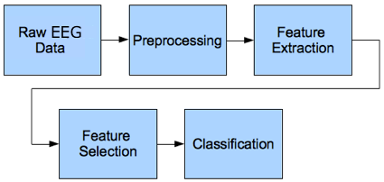
FLOW CHART/DIAGRAM

Slide 10
ADVANTAGES
Hardware costs are significantly lower than those of most other techniques.
EEG sensors can be used in more places than fMRI, SPECT,PET, MRS
or MEG, as they require bulky and immobile equipment.
Detects very rapid changes in electrical activity easily, allowing
analysis of stages of cognitive activity.
EEG is relatively tolerant of subject movement.
EEG is silent which allows for better study of responses .
EEG can be used in subjects who are incapable of making motor response.

Slide 11
LIMITATIONS
Provides poor spatial resolution of the source of electrical
activity.
Sometimes combined with magneto encephalography (MEG).
Signal to noise ratio is poor .
It takes time to connect a subject to EEG

Slide 12
APPLICATIONS
Bioengineering applications: Assist devices for disabled people.
Human subject monitoring: Sleep disorders, neurological diseases, attention monitoring, and/or overall "mental state".
Neuroscience research: Real-time methods for correlating observable behavior with recorded neural signals.
Man – Machine Interaction: Interface devices between human and computers, machines.

Slide 13
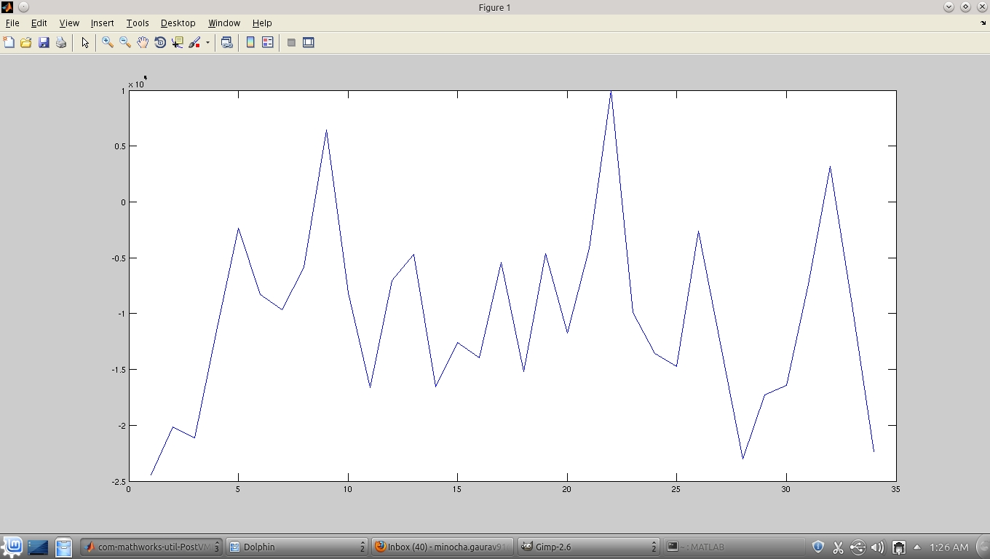
SIGNAL PREPROCESSING
Plot of EEG Data

Slide 14
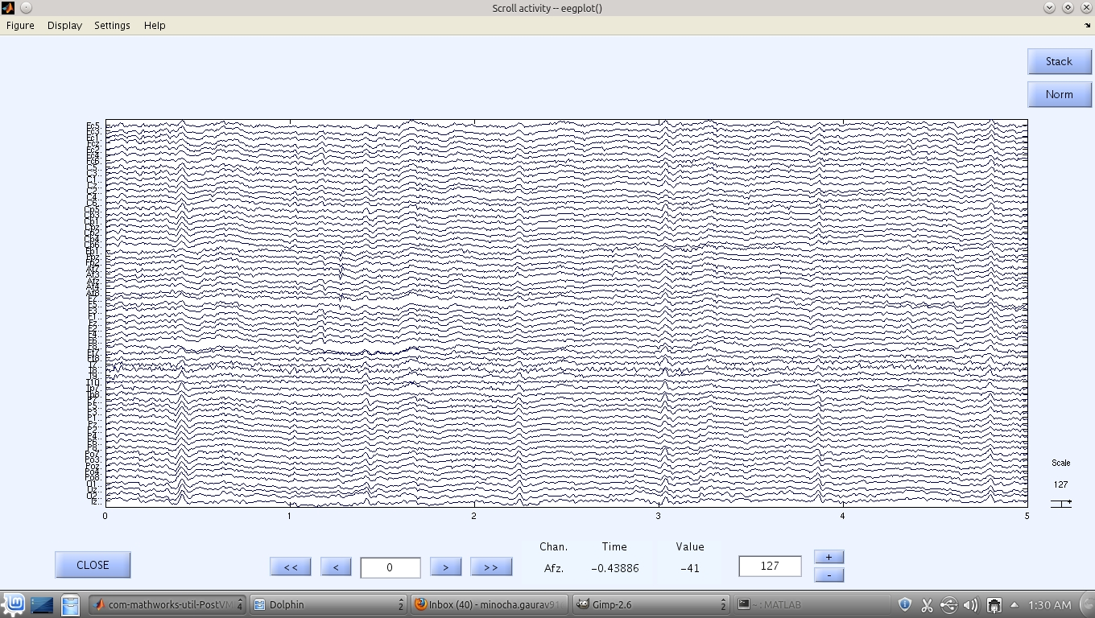
Plot of individual data of electrodes

Slide 15
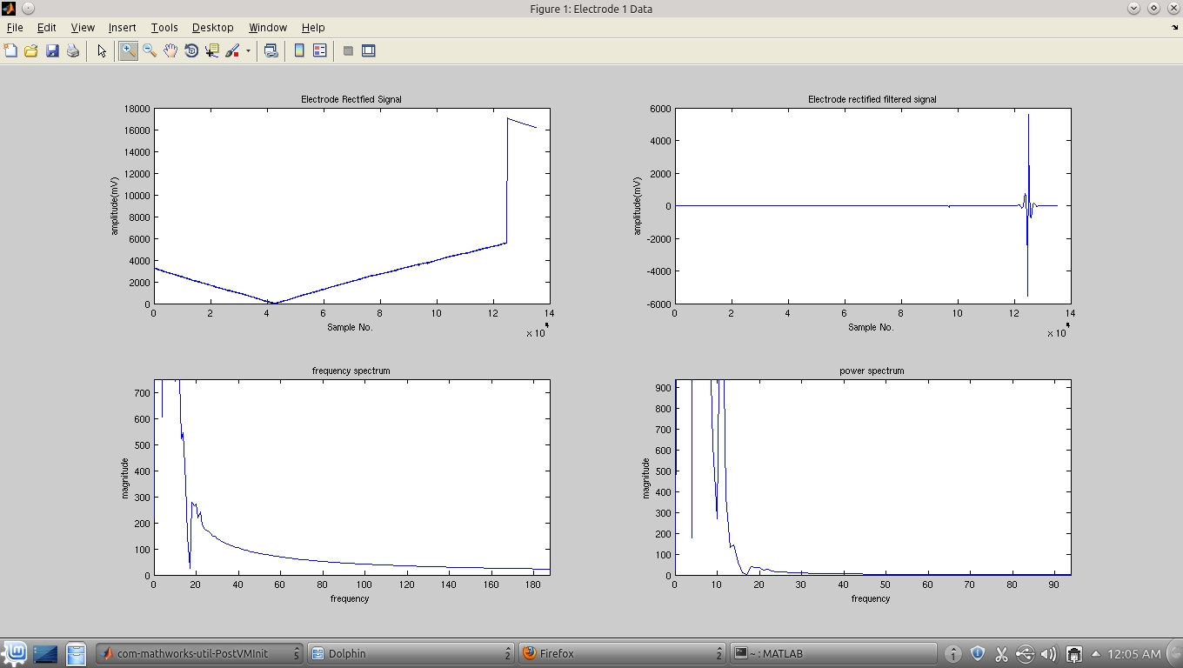
Plot of Electrode1 Data (Occipital Lobe)

Slide 16
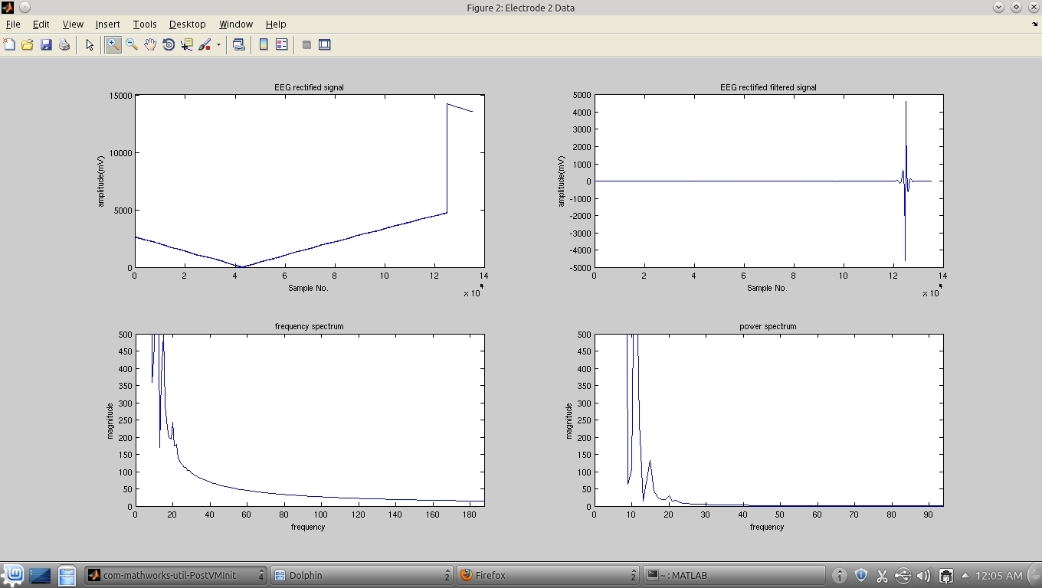
Electrode 2 Data (Occipital Lobe)

Slide 17
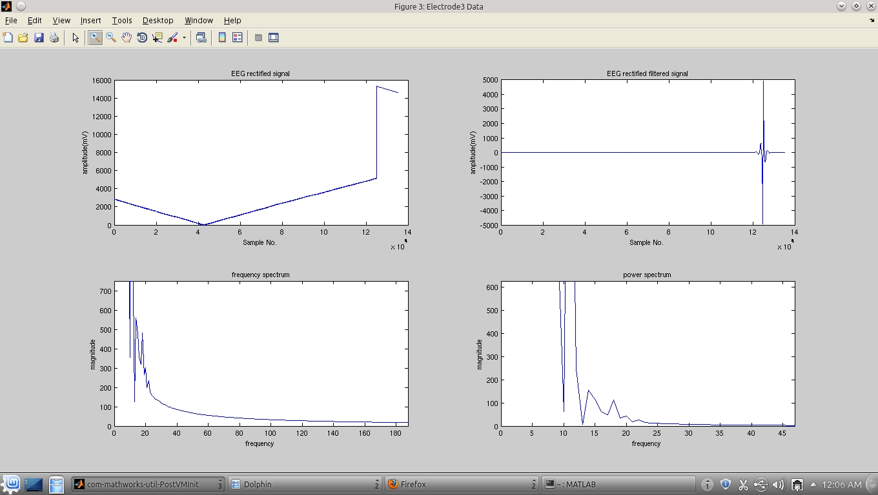
Plot of Electrode 3 Data ( Temporal Lobe)

Slide 18
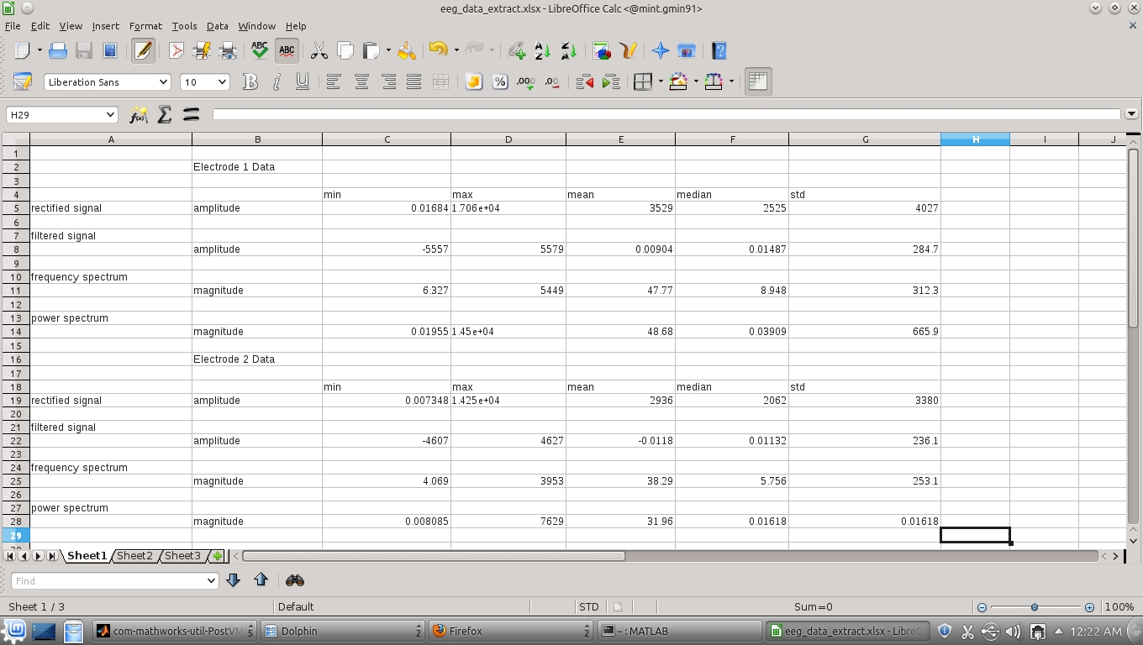
Figure showing the Data extracted from the three electrodes

Slide 19
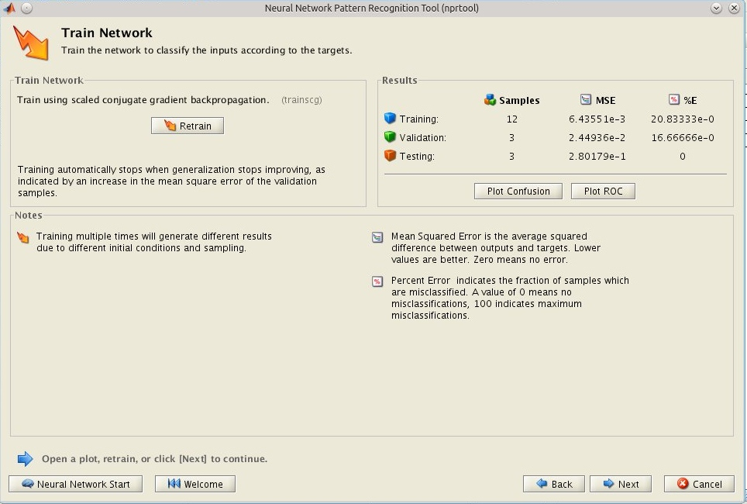
Classification Results

Slide 20
Classification Results

Slide 21
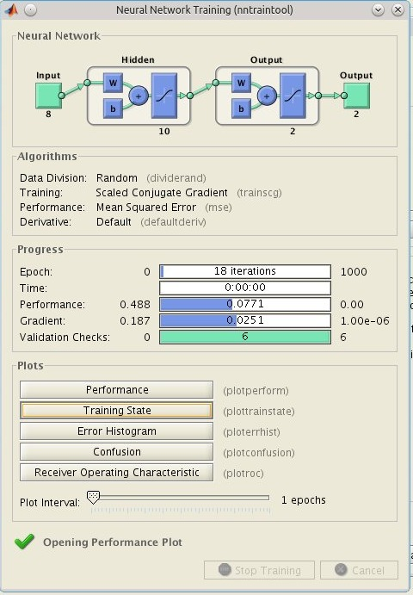
Training Tool

Slide 22
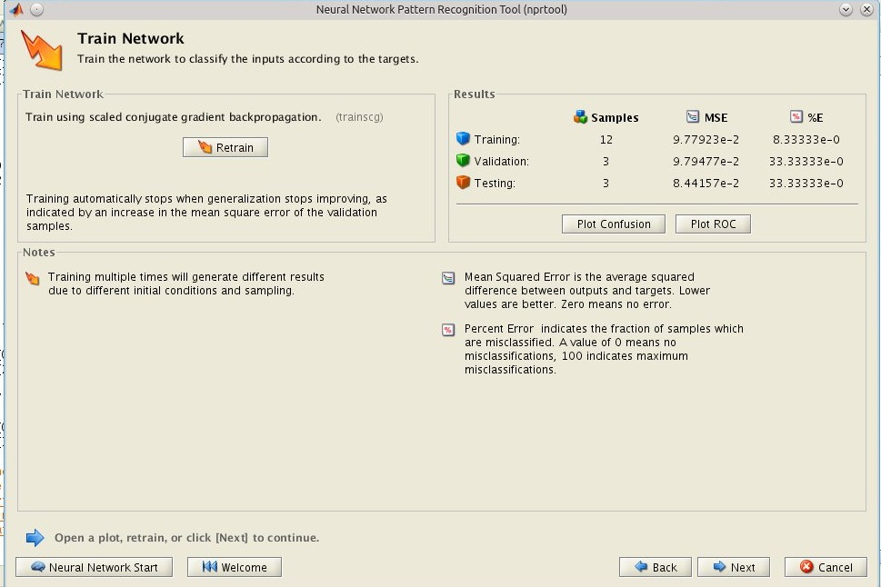
Classification Results

Slide 23
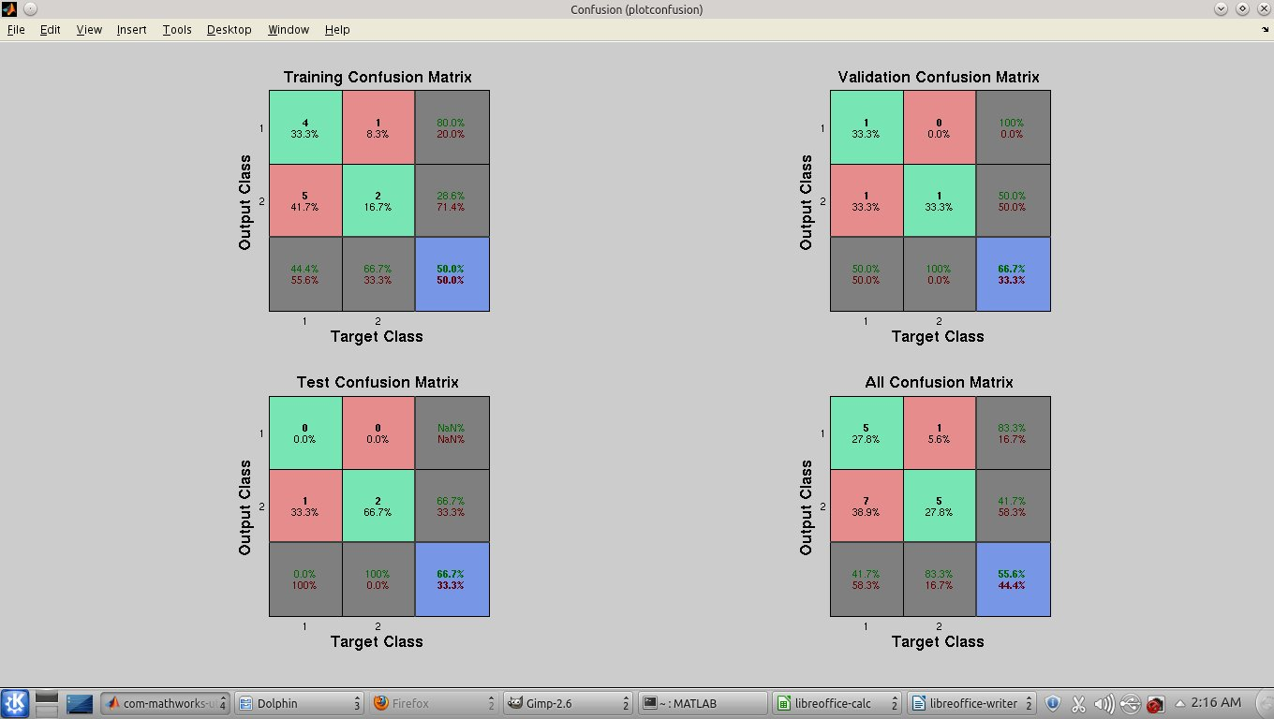
Confusion Matrix

Slide 24
DIFFUCULTIES / CHALLENGES BEING FACED
The EEG data has very large amount of data owing to large numbers of electrodes used to acquire the signals. Due to this very high amount of processing is needed to design the BCI.
Various types of filters are used for processing. So the classification depends on the types of filters used which are difficult to predict for various subjects.
The classification efficiency depends on the types of features used in the classifier which can vary greatly from subject to subject.

Slide 25
Conclusion and FUTURE SCOPE
The accuracy of the classification fresults are found to be in the range 70-88%
To improve the efficiency of classification we have to use various efficient algorithms of classification and extraction (like STFT, Ambiguity function and energy density transforms)

Slide 26
Application Software Used
MATLAB version 12a
EEGLAB

Slide 27
REFERENCES
1 . [June 2003] Deon Garrett, David A. Peterson, Charles W. Anderson, Michael H. Thaut
Comparison of Linear and Nonlinear Methods for EEG Signal Classification
2. [December 2000] Herbert Ramoser, Johannes Müller-Gerking, and Gert Pfurtscheller
Features extraction techniques of EEG signal for BCI applications
3. [December 2004] Abdul-Bary Raouf Suleiman, Toka Abdul-Hammed Fatehi
EEG and VEP Signal Processing

